Slide 1
Sagemaker Canvas

Slide 2
Introduction about the tool
SageMaker Canvas is part of Amazon SageMaker, which is a comprehensive machine learning platform by AWS.
Visual model building: Canvas allows users to create and customize machine learning models using a visual interface, making it accessible to non-programmers.
Collaboration: Canvas supports collaboration among team members on machine learning projects.
Canvas is for those who want to build machine learning models without extensive coding and want to leverage the broader SageMaker ecosystem for ML workflows.

Slide 3
Advantages
Disadvantages
Merging datasets using joins
Cost efficient for a smaller data set
Ability to share or edit the dashboard with another user
Allows Batch /Single prediction
Quick execution
More secure than free tools
Data Size
Paid software
Costs for storage
Hyperparameter Tuning Complexity
Tightly integrated with the AWS ecosystem

Slide 4
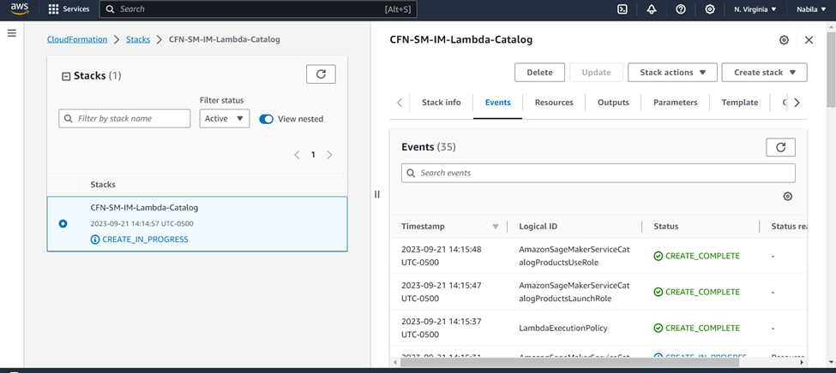
Our experience of using the tools
We have to open the AWS CloudFormation console and create our SageMaker Studio domain and a user named studio-user. It will add the required permissions to our SageMaker Studio account. Once the catalog is created, then we can open the Amazon Sagemaker Canvas through the search bar.

Slide 5
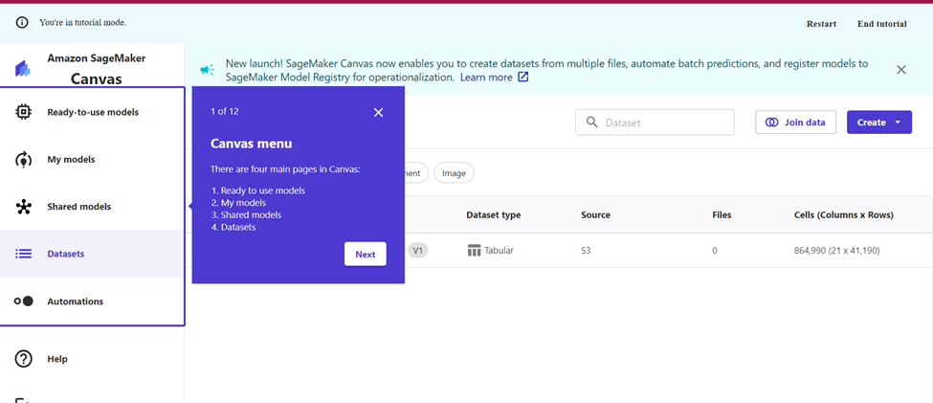
Our experience of using the tools
This is the Canvas dashboard and we can do all our Machine Learning operations in this tool.

Slide 6
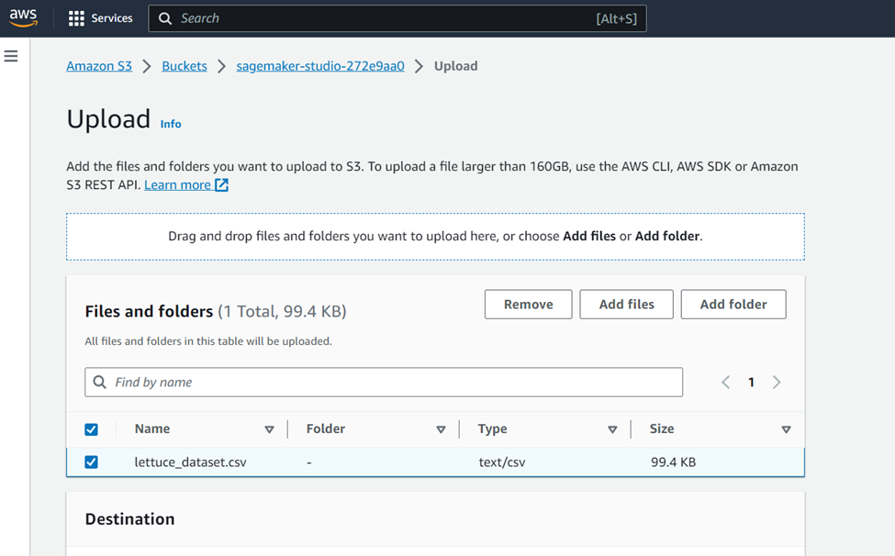
Our experience of using the tools
We then upload the datasets (Lettuce) to the default S3 bucket that SageMaker Canvas has created for us.

Slide 7
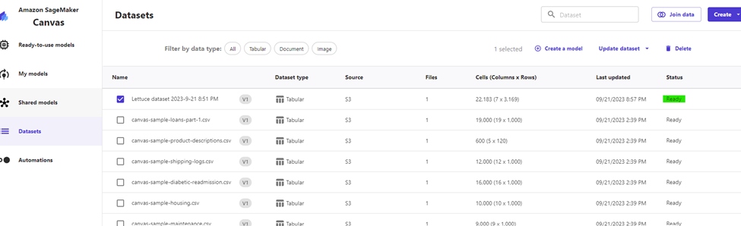
Our experience of using the tools
Once the csv file is uploaded and the status is ready, then we can create the model.

Slide 8
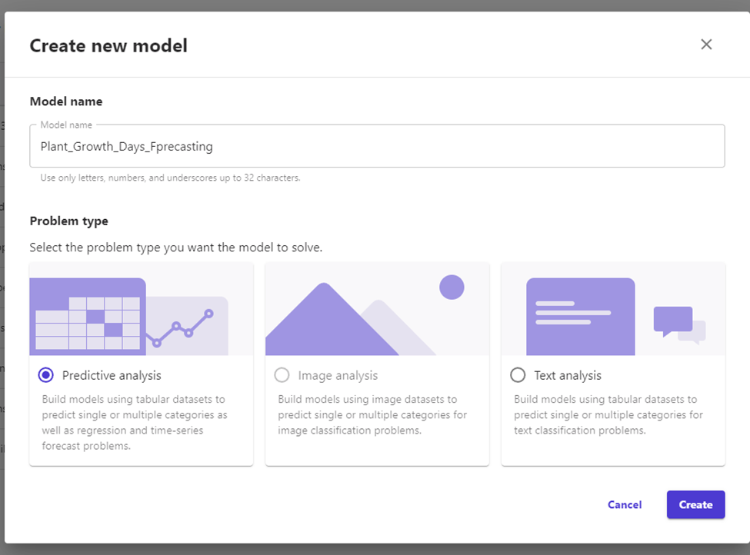
Our experience of using the tools
The tool provides us the option of what type of model needs to be created.

Slide 9
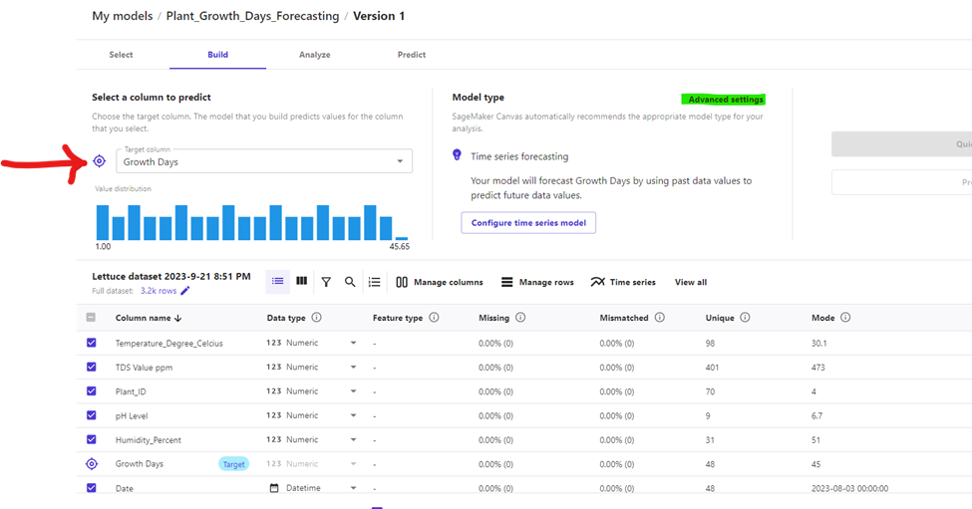
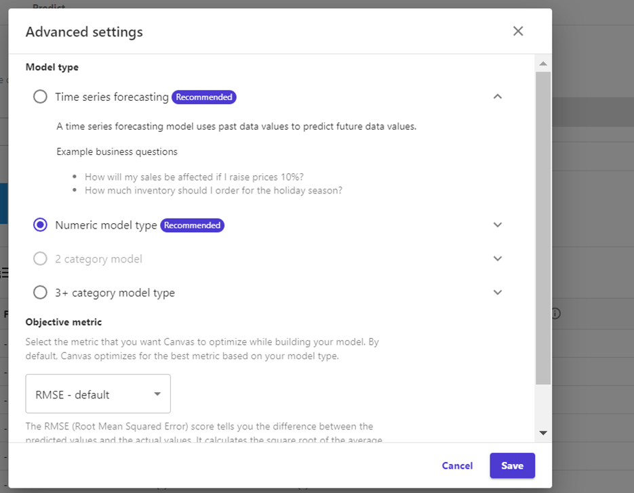
Our experience of using the tools
Once, we have decided on the model, Canvas allows us to select the target column and automatically tries to infer the problem type. Our target variable is Growth Days. Here we chose the Numeric model type.

Slide 10
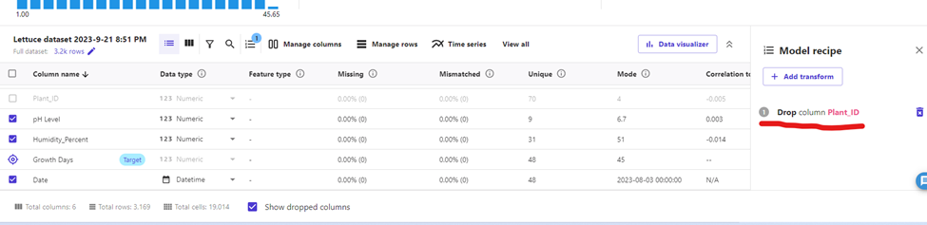
Our experience of using the tools
In the build tab itself, Canvas provides dataset statistics. We have the option to drop any column that is not correlated with the target variable. In our dataset we dropped Plant_ID.
After we are done with data exploration, we are ready to train the model. In Canvas, there are two methods for training: Quick Build (10 to 15 min) and Standard Build(2 to 4 hrs). Here we chose the quick build option.

Slide 11
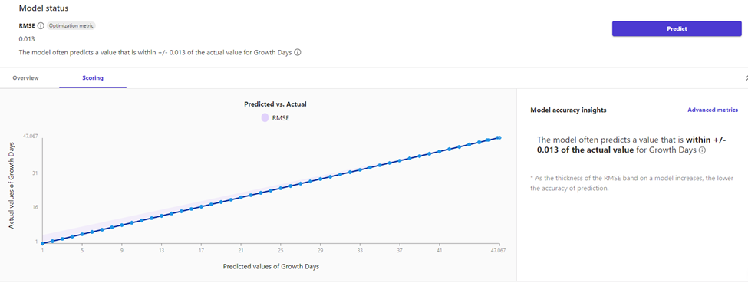
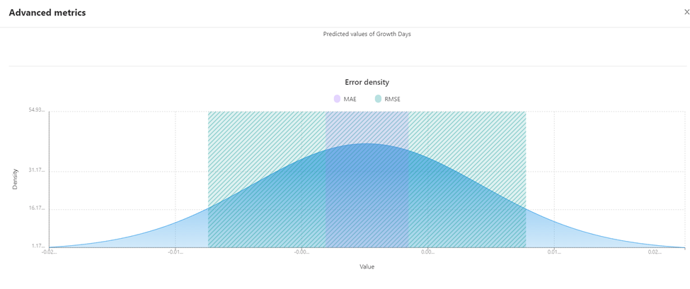
Our experience of using the tools
Once the model is trained, we then switch to Analyse tab to see the quick training results. On the Scoring tab(below), we can see a plot showing us the best fit regression line for GrowthDays. The model built using Quick build predicted the number of growth days within +/-0.013 of the actual value.
Also, there is an error density plot which shows the distribution of the errors with respect to MAE and RMSE of the model. An error density with a shape similar to a normal distribution is indicative of good model performance.

Slide 12
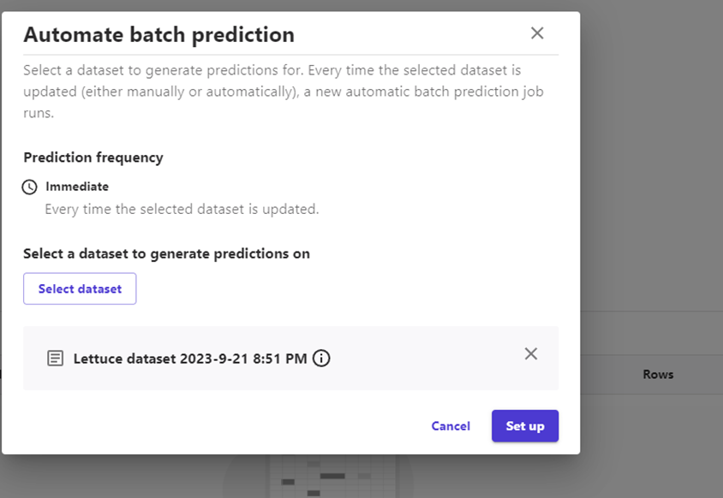
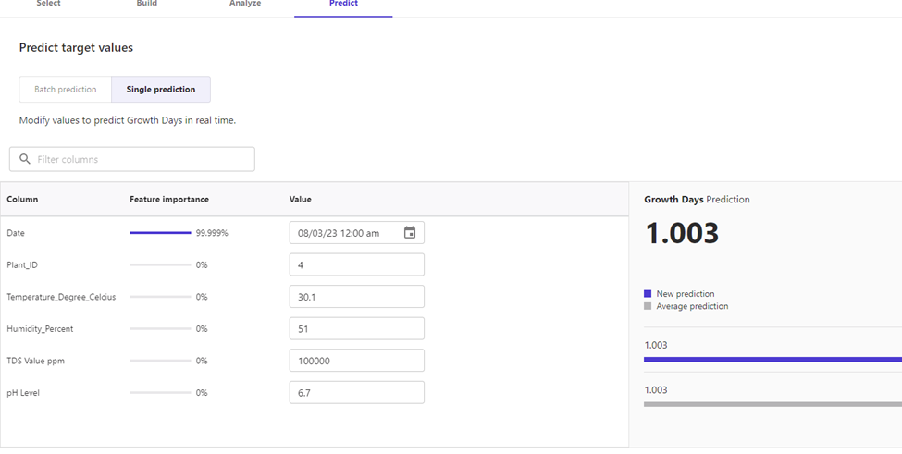
Our experience of using the tools
Now, that we have analysed the model, we can do predictions: Single or Batch. We selected Batch Prediction. We can generate predictions for a single sample by selecting Single prediction. With this feature, we can manually enter values for each of the input variables used in the model and evaluate individual feature importance. We can see the columns which have the highest influence on the sample prediction.

Slide 13
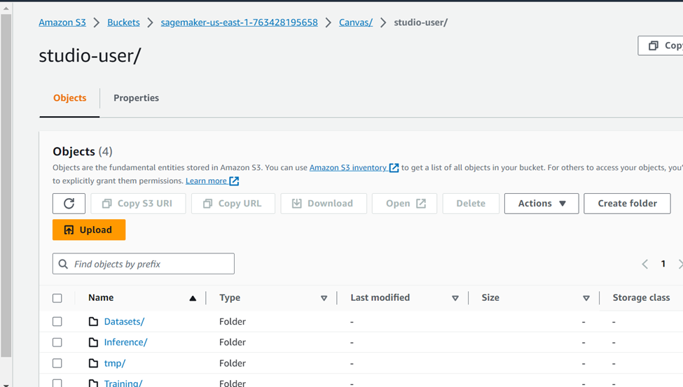
Our experience of using the tools
Canvas allows upload of the trained model to the default S3 bucket, which can be used for further development.

Slide 14
Comparison with similar tools
 | KNIME Analytics | Amazon SageMaker Canvas
Vendor and Ecosystem | Open-source data analytics platform for data preprocessing, analysis, and machine learning. | It is primarily designed for building, training, and deploying machine learning models on AWS.
Ease of Use | The drag-and-drop interface enhances accessibility, catering to users with diverse technical backgrounds. | Provides a graphical interface for building machine learning models, making it more accessible to users who may not have extensive coding experience.
Machine Learning Capabilities | It offers popular machine learning libraries such as Scikit-learn, TensorFlow, and XGBoost. | It is more focused on providing a simplified, no-code/low-code interface for creating and deploying models.
Cost | It is an open-source and free tool, with optional commercial extensions and support available. | It is subject to AWS pricing, which can include charges for data storage, compute resources, and machine learning services.

Slide 15
Thank You!

